Slide 1
How to Code Your Documents for Signature Page Generator
Drew Gandy
Holland & Knight LLP
Atlanta - x48518

Slide 2
Background on How Sig Page Generator Works
You add hidden text code on each signature page for each of your documents to indicate to the software that the current page is a signature page and who signs it.
The hidden text looks like this: “##Signature Page-Borrower##” with “Borrower” being replaced with whoever is signing the page.
Because this text is hidden, it typically doesn’t show up (unless you are viewing formatting in MS Word) and will not appear when printed or if a PDF is created.
The software then opens each document and searches for that hidden text.
When the hidden text is found, the software creates a PDF of that page, naming it for the appropriate signatory.
When all of the documents have been processed, the software collates the individual PDF pages into separate packets for each signatory.

Slide 3
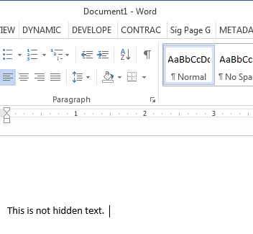
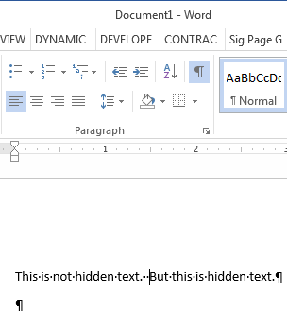
Working with Hidden Text: Showing/Hiding Hidden Text
To show/hide hidden text, click the ¶ icon in the Paragraph section of the Home ribbon.
Note the examples below. Hidden text has a dotted line underneath.

Slide 4
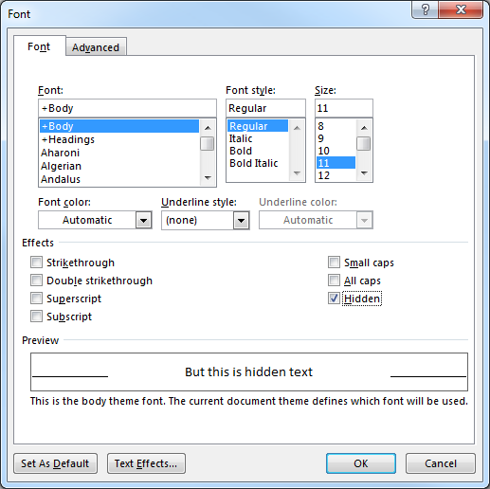
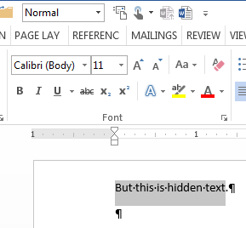
Working with Hidden Text: Creating Hidden Text
Select the text you want to make hidden.
Click the arrow in the bottom right corner of the Font section of the Home ribbon.
Select the “Hidden” checkbox in the effects list.
Then click “OK”.

Slide 5
Coding Your Documents
On each signature page, add the following snippet as hidden text :
##Signature Page-[Signatory]##
Replace “[Signatory]” with the party that is signing that page.
e.g. ##Signature Page-Borrower##
If more than one party signs the same page, add a snippet for each party.
e.g. ##Signature Page-Borrower## ##Signature Page-Lender##

Slide 6
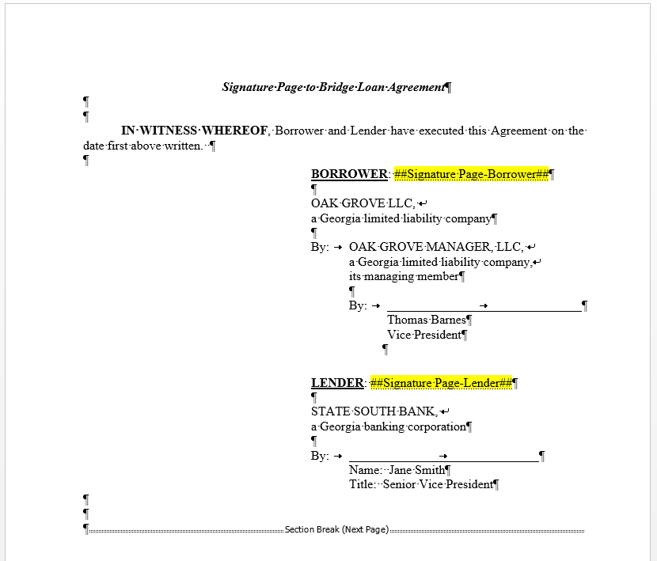
Example (highlighting is only for reference purposes and not necessary.)

Slide 7
Advanced Coding
If you only want a certain number of copies of a specific signature page to be generated, even if multiple copies of other pages are being generated, add [Limit=#], where # is the maximum number of copies.
e.g. ##Signature Page-Borrower [Limit=1]##
This is helpful, for instance, when Borrower signs 3 copies of all of the loan documents, but only signs 1 copy of the promissory note.
See SPG Example – Promissory Note.docx for an example
If a signature page encompasses more than one page, you can use [Pages=#], where # is the total number of consecutive pages this signatory signs
e.g. ##Signature Page-Borrower [Pages=2]##
This is useful where a party signs one signature page, and a notary acknowledges that party’s signature on the next page. By including [Pages=#], those pages will always be kept together in the packet.
See SPG Example – Deed of Trust.docx for an example
Separate packets can be made for the same party by naming the party differently in the snippet.
e.g. ##Signature Page-Borrower (Recordable) ## for signature pages to be sent to the title company, and ##Signature Page-Borrower (Non-Recordable) ## for signature pages that are to be sent to H&K.
This is useful when a party is sending signed packets to different destinations.
You can put any text (other than #, [, ] and -) where [Signatory] is in ##Signature Page-[Signatory]##.
See SPG Example – Deed of Trust.docx for an example

Slide 8
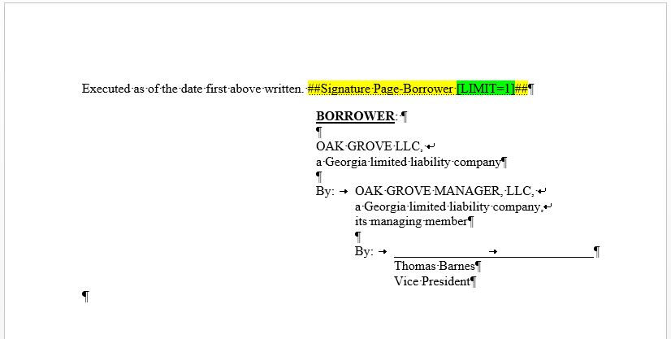
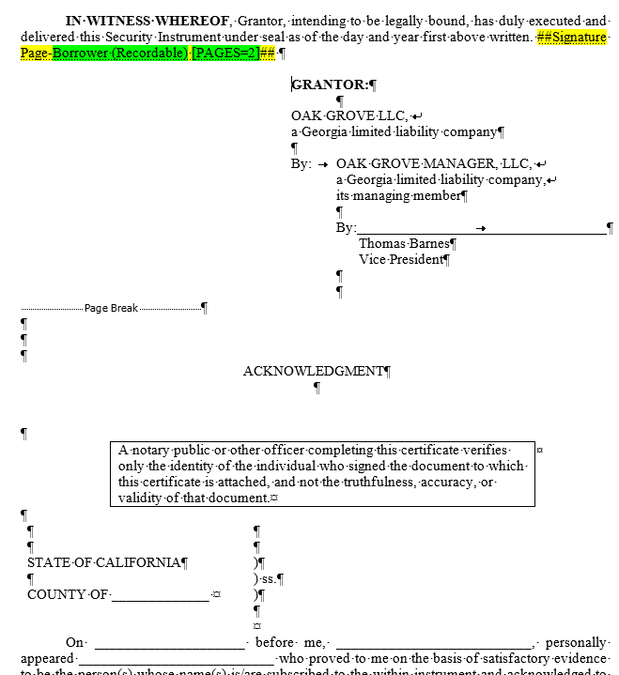
Examples (highlighting is only for reference purposes and not necessary.)
[LIMIT=#]
[PAGES=#] and Separate packets for same signatory (note notary block after Page Break)

Slide 9
Things to Keep in Mind…
I try and insert the hidden text snippets in the signature page lead-in sentence or another location that is unlikely to be edited (as opposed to inserting it within the signature block). If the signature block is updated at a later date by copying and pasting a new block over the old block, the snippet may be deleted inadvertently.
If the same party signs the same page more than once, and you only want that party to sign a single page (as opposed to signing separate pages for each party), you will want to only include a single snippet for all of the related parties.
For example, if the same individual signs for both the Guarantor and Borrower, and the Guarantor and Borrower both sign the same signature page, you would only insert ##Signature Page-Borrower## and not include ##Signature Page-Guarantor##, because you ultimately only want 1 signature page for both Borrower and Guarantor.
See SPG Example – Guaranty.docx for an example
If your signature page breaks across 2 pages when hidden text and formatting is visible, that signature page may not output correctly.
It is important to make sure your signature page is entirely on one page.
This occurs most often when there is a signature block and notary block on the same page.
See SPG Example – Sig Page That’s Too Long.docx for an example

Slide 10
How to Generate Signature Pages
Drew Gandy
Atlanta - x48518

Slide 11
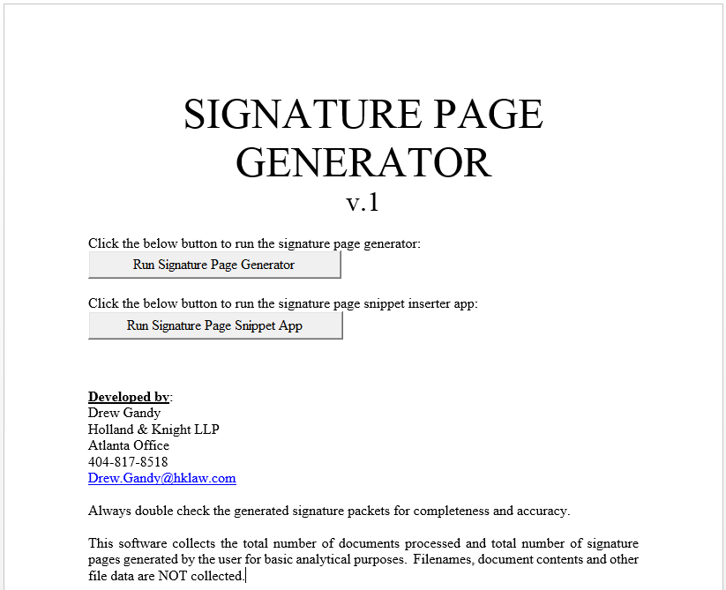
Open the “Sig Page Generator.docm” document

Slide 12
Click “Run Signature Page Generator”

Slide 13
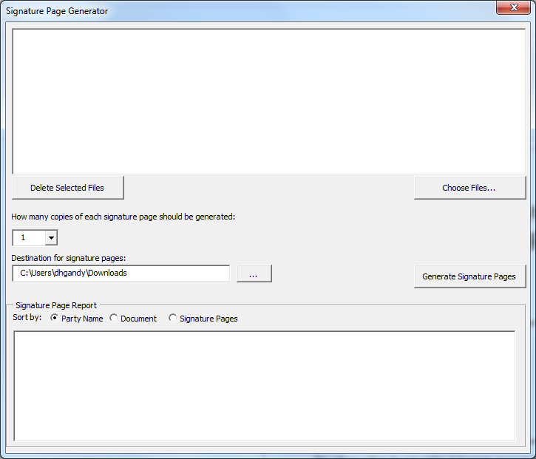
This is the Signature Page Generator interface
From here you can:
Add and remove your documents from the list of documents to process
Select how many copies of each signature page you want
Select the destination for the signature packets
Review the report of all signature pages generated

Slide 14
Click “Choose Files…” to select documents to pull signature pages from.
Note that this software cannot (yet) interface with iManage. Thus, you will need to save any iManage documents locally before running them through the software.
To export several files from iManage at once, I select all of the files I want, right click them, click “Send” then “Send Document.” This will create an Outlook email. You can now drag the files from the Outlook email to a local folder.
“Delete Selected Files” will remove the selected items from the list.

Slide 15
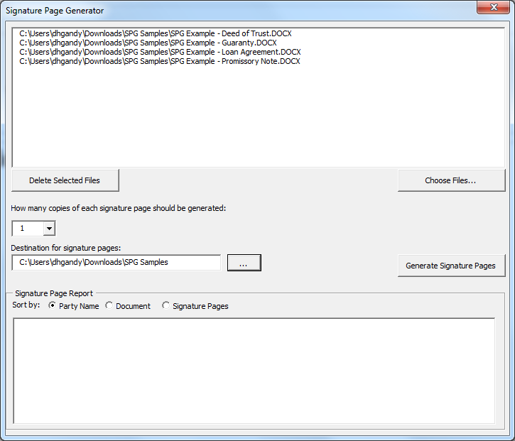
Choose options…
Select the number of copies of each signature page to be generated.
Select the location where the signature packets should be saved.

Slide 16
Click “Generate Signature Pages” to generate packets

Slide 17
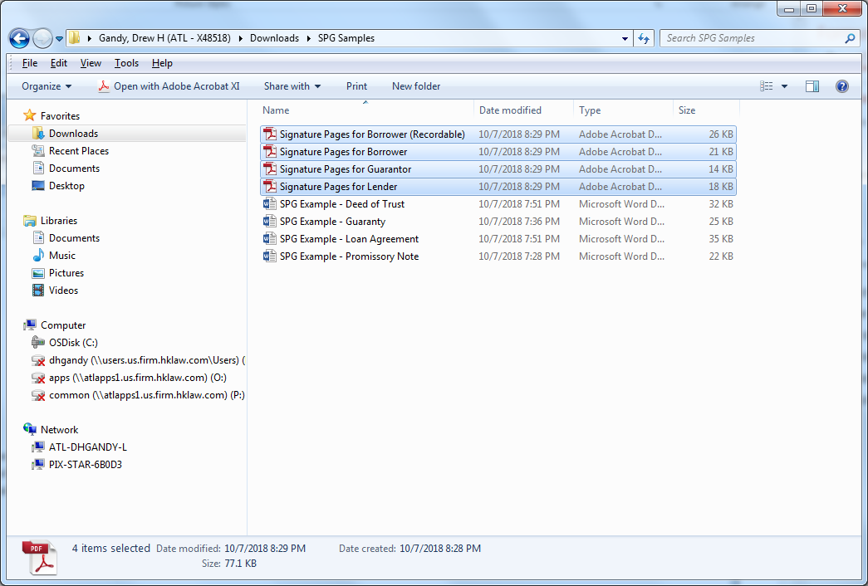
That’s it…
The packets will be created in the destination folder.
Once done, you can review the Signature Page Report to confirm the appropriate signature pages were created.
This list can be copied and pasted in the email distributing the packets if you want to identify which parties sign which documents.

Slide 18
What’s on the roadmap
iManage integration
Custom cover pages included in packets for mailing instructions, etc.
Update signature blocks and other info in documents on the fly
Draft tag management
When a new version is created, draft tag is blanked out (e.g. “10/__/18”)
When ready to circulate documents to working group, draft tags are filled in

Slide 19
Don’t hesitate to let me know if you have any questions or comments.
Email: drew.gandy@hklaw.com
Phone: 404-817-8518 or x48518

Slide 20
Setting Up Signature Page Generator Software
Drew Gandy
Holland & Knight LLP
Atlanta - x48518

Slide 21
Download “Sig Page Generator.docm” document
The software is built into a Word document.
The latest version may be obtained here:
https://github.com/drewgandy/Sig-Page-Generator/raw/master/Sig%20Page%20Generator.docm
The latest version of this user guide may be obtained here:
https://github.com/drewgandy/Sig-Page-Generator/raw/master/Sig%20Page%20Generator%20User%20Guide.pdf

Slide 22
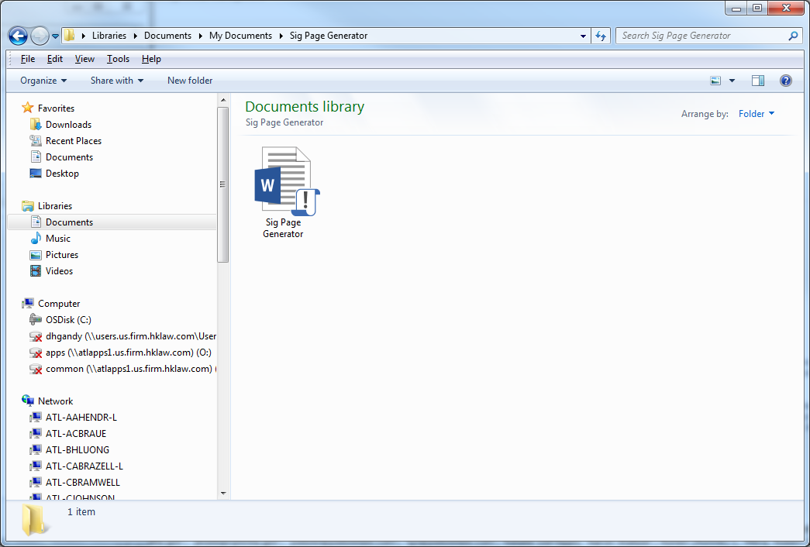
Save the Word Document somewhere convenient. Remember where you saved it…
You will be using this document to run the Signature Page Generator interface.
The document should be saved in a folder where you will not save any other files.
The suggested location is a sub-folder in the My Documents folder:
“C:\Users\[Username]\ Documents\Sig Page Generator\”

Slide 23
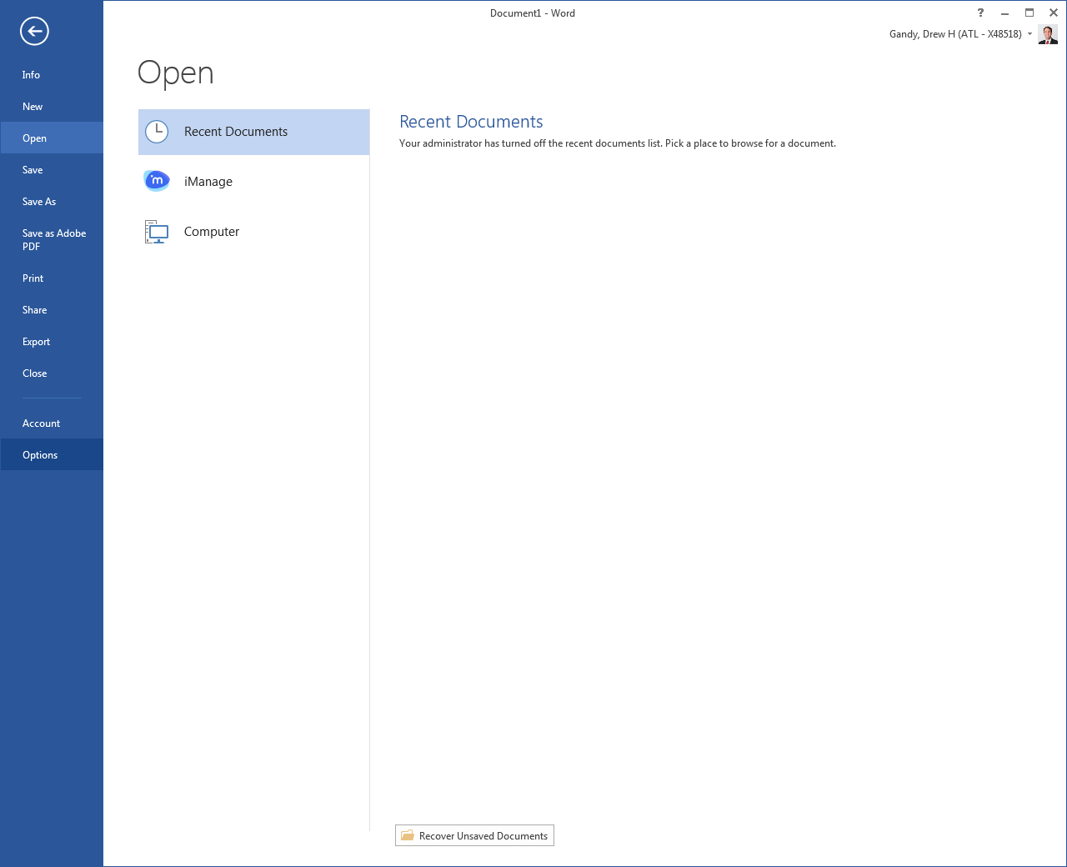
Open MS Word, click the “File” tab and select “Options”

Slide 24
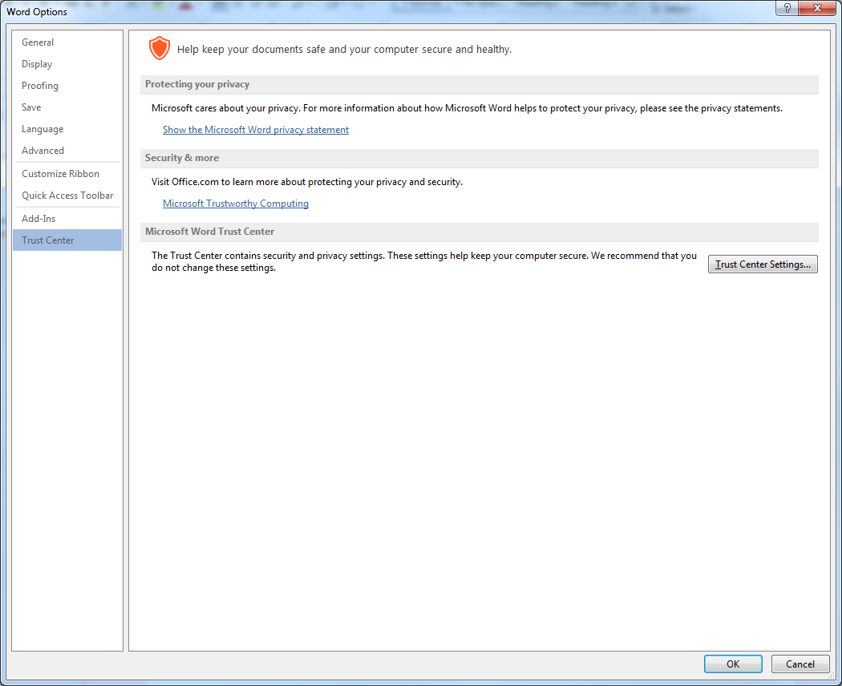
Click “Trust Center” from the list on the right…
Then click “Trust Center Settings…”

Slide 25
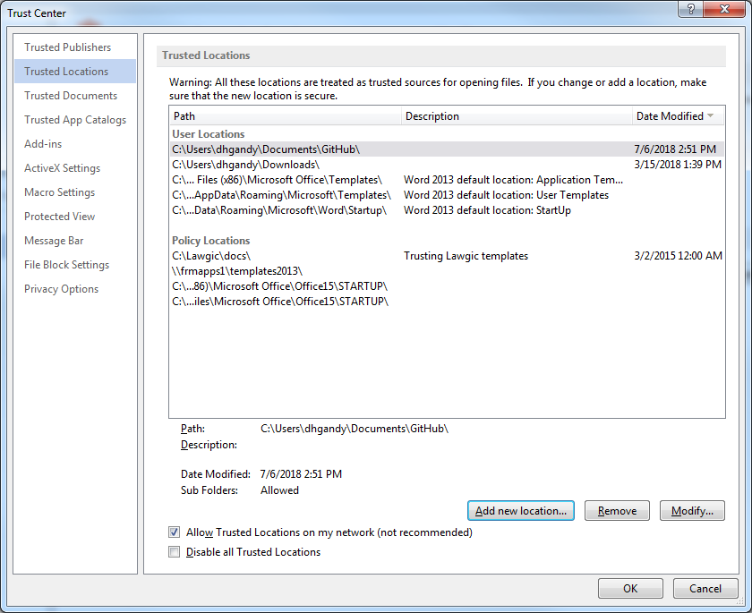
Click “Trusted Locations” from the list on the right…
Then click “Add new location…”

Slide 26
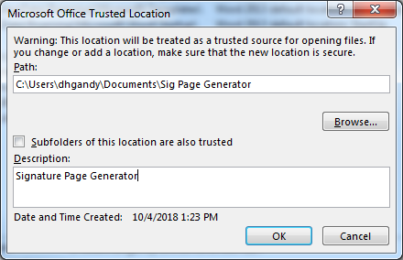
Enter the folder location in the “Path:” textbox where you saved the Word document…
Then click “OK”
You can fill in a description, but this is not necessary.
If you move the “Sig Page Generator.docm” file to another folder, you will need to update the location in this path.

Slide 27
Click “OK” in the Trust Center window

Slide 28
Click “OK” in the Word Options window

Slide 29

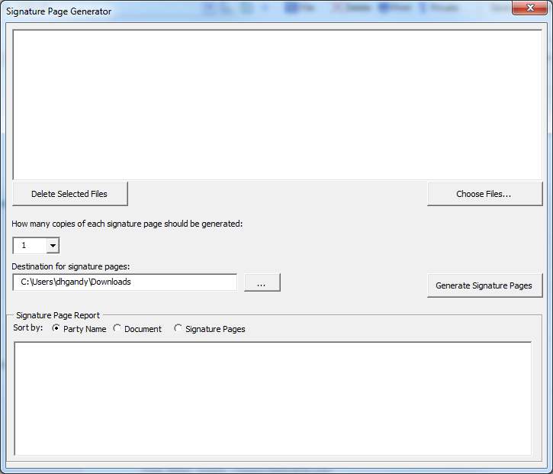
That’s it! You’re done. Let’s test that the setup worked…
Open “Sig Page Generator.docm” from where you saved it.
Click the “Run Signature Page Generator” button embedded in the Word document.
If the following screen appears, the software was setup correctly.
You can now close MS Word if you’d like.

Slide 30
How to update to the latest version
When a new version comes out, you do not need to repeat all of these instructions.
Just copy the new “Sig Page Generator.docm” file that you downloaded to where the old version is saved and replace it.

